Slide 1
ARM Processor And Applications
Course Code: 22EEIP215
COURSE PROJECT-1
Team: 9 Div: A (II)
NAME | USN | ROLL NO
VINAYAK BHAJANTRI | 01FE21BEI028 | 125
VINAYAK JAINAPUR | 01FE21BEI047 | 140
ABDUL RAZZAK YERGATTI | 01FE21BEI049 | 142
KARTHIK I C | 01FE21BEI411 | 165

Slide 2
PROBLEM STATEMENT
Develop an automatic door opener system using ultrasonic sensors to detect the presence of a person approaching the door. Use the LPC2148 to control the door mechanism only after authentication and provide hands-free access to buildings or rooms.

Slide 3
PROBLEM ANALYSIS
Peripherals used :
SL NO | PERIPHERALS
1) | LCD
2) | Buzzer
3) | Stepper motor
4) | DC motor
5) | SENSOR -Ultrasonic sensor
6) | UART

Slide 4
PERIPHERALS SPECIFICATION
1. 16X2 LCD Interface
2. Stepper motor Interface: Port lines used for Stepper motor are P0.12
– P0.15
3. DC motor Interface: Port lines used for DC motor are P0.8 and P0.9.
4. BUZZER
5. UART: Communication protocol

Slide 5
ASSUMPTIONS MADE
Sensor Placement
Authentication Database Sensor
Accuracy: The ultrasonic sensor provides accurate distance measurements for reliable presence detection.
Communication Interface(UART)
Power Supply
Door Mechanism Compatibility
Programming and Libraries

Slide 6
FEATURES
Ultrasonic Presence Detection
Authentication Mechanism
LPC2148 Microcontroller
Door Control Mechanism
Status Indication
Safety Features(Buzzer)

Slide 7
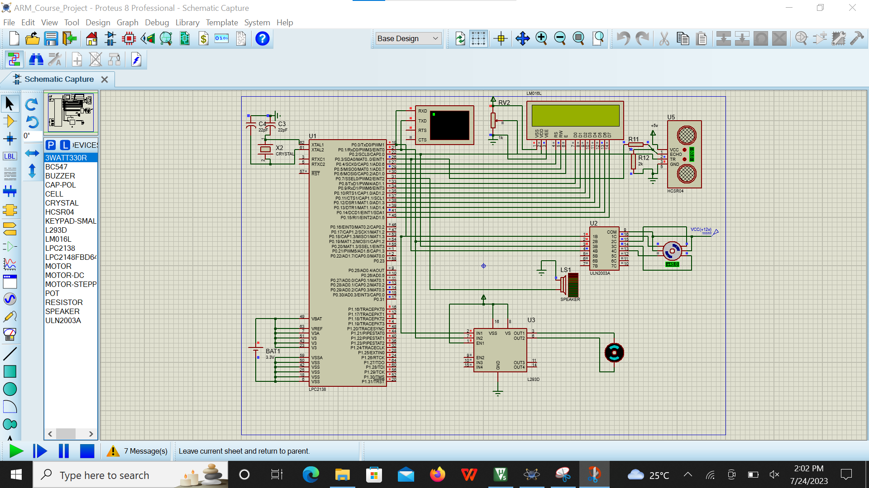
INTERFACING

Slide 8
ALGORITHM
1. Ultrasonic sensor senses the user.
2. Initialize the UART, keypad, and LCD display.
3. If distance<50cm open door for the first step considered as gate.
4. After 5 secs of interrupt delay,Prompt the user to enter the password through the UART.
5. Enter an infinite loop to continuously monitor the security system.
6. Mask the entered characters with '*' and verify the password.
7. If the password is correct, generate a random OTP.
8. Display the OTP on the LCD display.
9. Prompt the user to enter the OTP through the UART.
10. Mask the entered characters with '*' and verify the OTP.
11. If the OTP is correct, display a success message on the LCD display and DC motor starts to open the door.
12. If the password is incorrect, display an error message on the LCD display.
13. If the OTP is incorrect, display an error message on the LCD display and Buzzer starts.
14. Repeat the process from step 3 for continuous security monitoring

Slide 9
BLOCK DIAGRAM
LCD
LPC2148
MICROCONTROLLER
STEPPER
KEYPAD
ULTRASONIC
SENSOR
UART

Slide 10
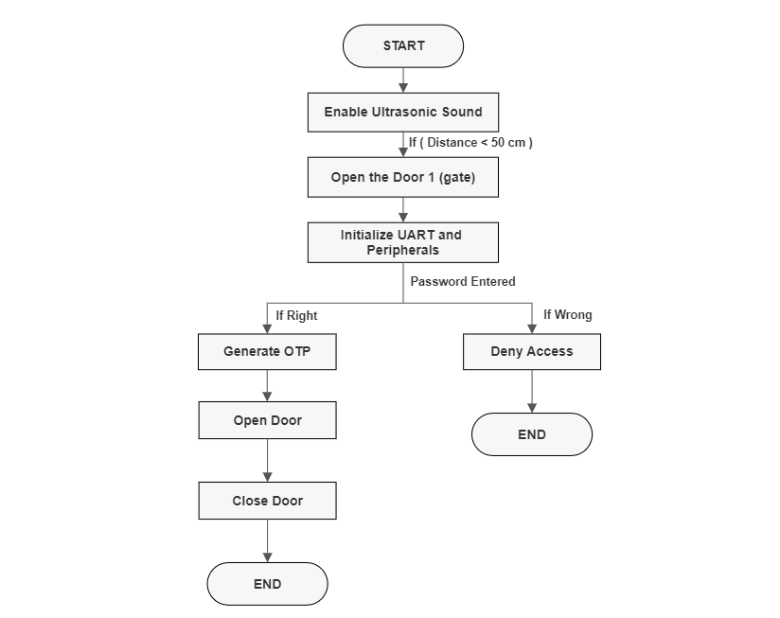
FLOW CHART

Slide 11
THANK YOU

